Slide 1

Security Gates Control System
Using IoT

Slide 2

Topics:
Introduction
Technologies
System Design
MQTT.Tag
Design
Problem statement
Internet of things
Flowcharts
What is MQTT.Tag?
Motivation
MQTT Protocol
Sequence Diagram
Application Main Flow
Brief view of project
System Model

Slide 3
Introduction
Technologies
System Design
MQTT.Tag Design
Problem statement
There is a need for a security system to control the entrance of parking in sensitive places. For instance, government/private companies are sensitive locations, which require control of the vehicles that enter the building. For such a location, a security gates control system is required. This gates system is used for a few users, which are only less than 100 users. The system solves the security problem of gates opening for authorized users only.

Slide 4
Introduction
Technologies
System Design
MQTT.Tag Design
Motivation
Smart barrier gates are uncommon.
we are interested in strengthening that field.
Some organizations require a gate security system better than a regular gate security system.
There is a need for a gate security system that ensures access for authorized-only people without the involvement of humans.

Slide 5
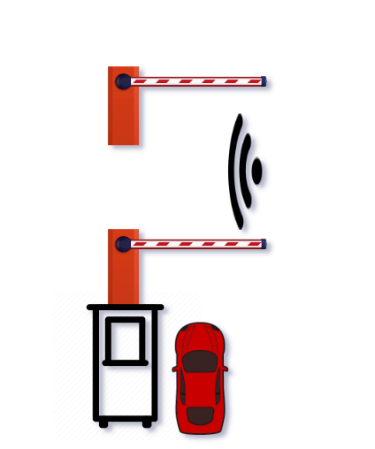
Introduction
Technologies
System Design
MQTT.Tag Design
Brief view of project
Our project uses IoT technology.
It provide two gates which make only one car to enter between them.
The gate 1 contain two stages of authentication to make sure the user is authentic.
The gate 2 is only to make sure only one car in between and feedback the info to gate 1 to start again.

Slide 6
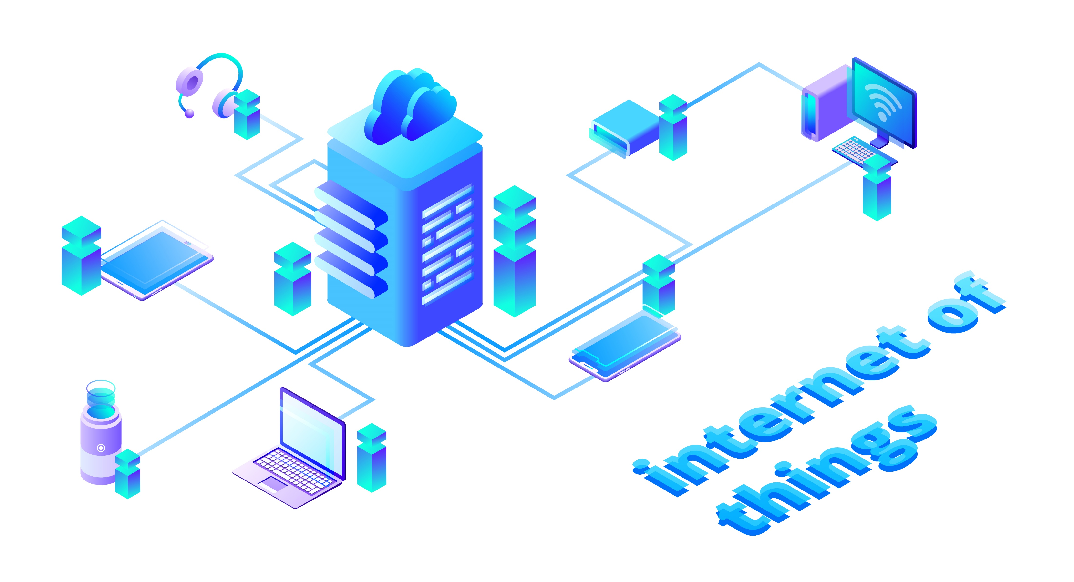
Introduction
Technologies
System Design
MQTT.Tag Design
Internet of things
Internet of things is a collection of physical objects connect to each other through network.
Internet of things has impact in last few years, a lot of projects were made such as smart cities.
We want to use Internet of thing technology to provide solution for our project.

Slide 7
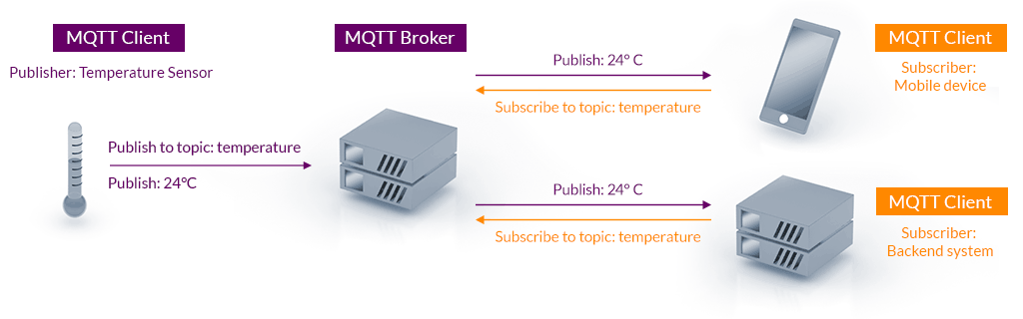
Introduction
Technologies
System Design
MQTT.Tag Design
MQTT Protocol
MQTT Protocol or Message Queueing Telemetry Protocol, is an application layer protocol which is important to IoT projects because it’s lightweight and more efficient for small devices .
MQTT Broker: is the server in the middle which is responsible for to transmit publishing topics from publishers to subscribers
MQTT Client (Subscriber): is the one who subscribe to specific topic.
MQTT Client (Publisher): is the one who publish on specific topic to give information to other subscriber.

Slide 8
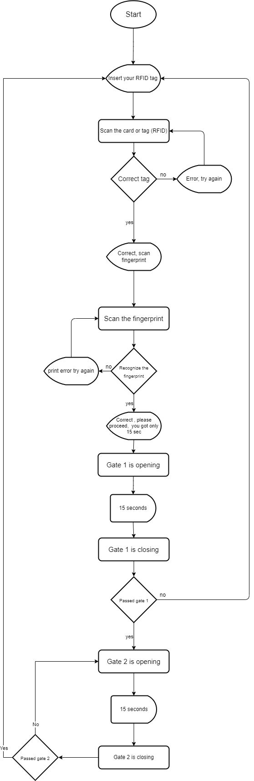
Introduction
Technologies
System Design
MQTT.Tag Design
Flowchart (User actions)

Slide 9
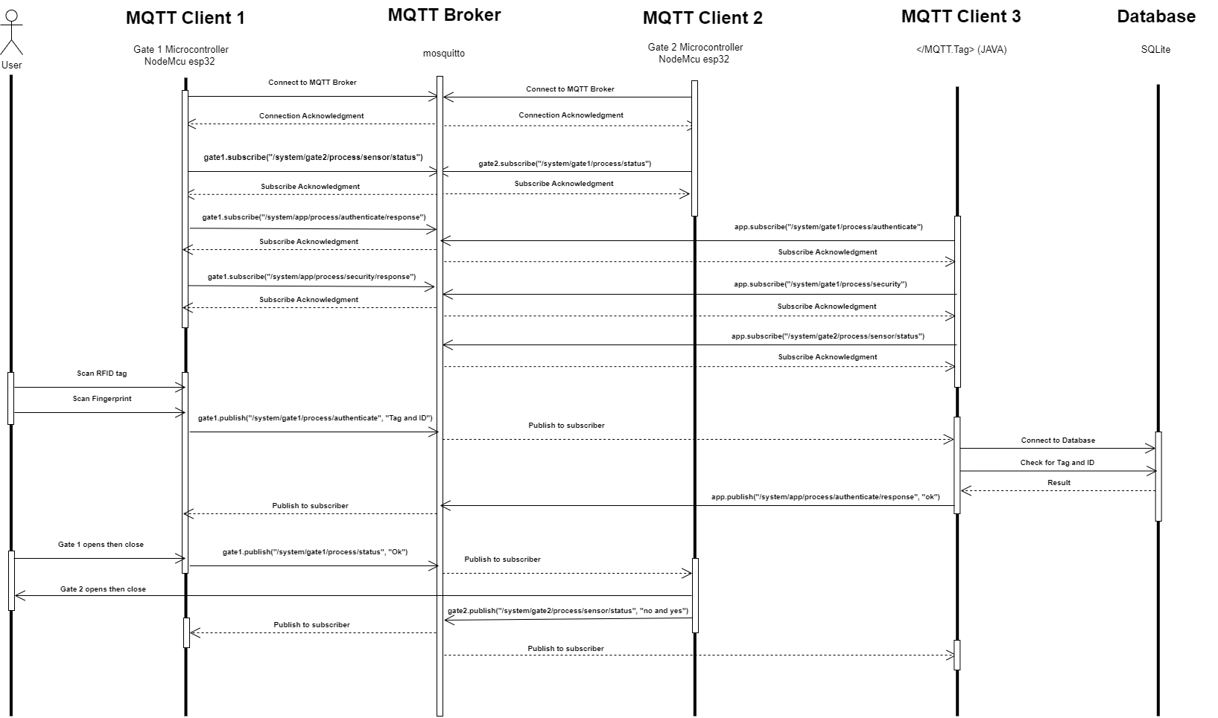
Introduction
Technologies
System Design
MQTT.Tag Design
Sequence Diagram

Slide 10
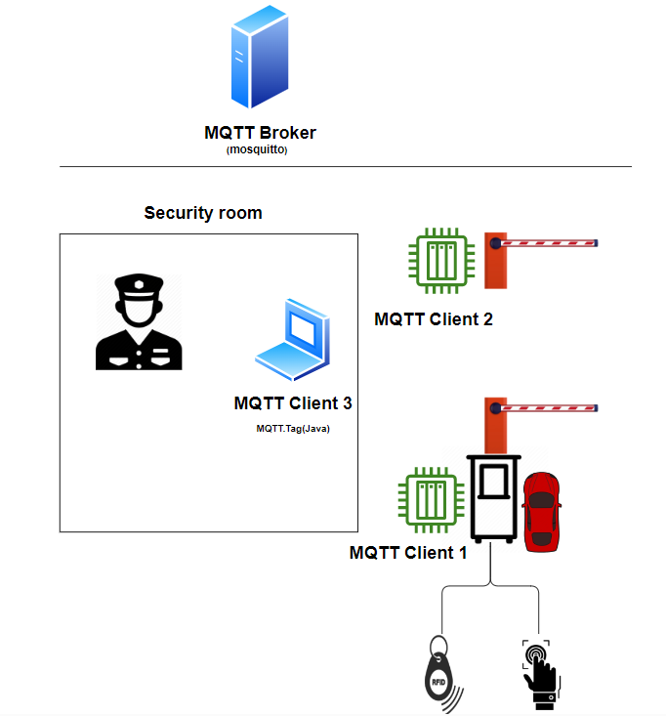
Introduction
Technologies
System Design
MQTT.Tag Design
System Model
Diagram

Slide 11
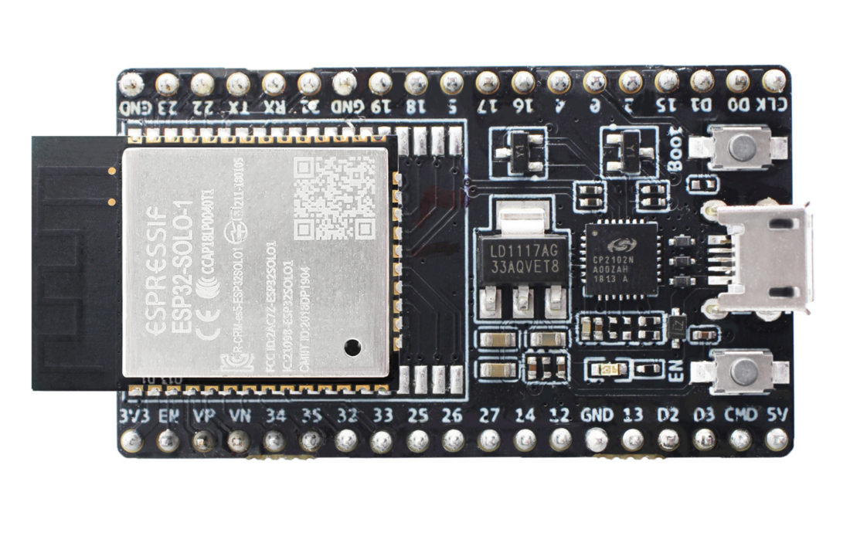
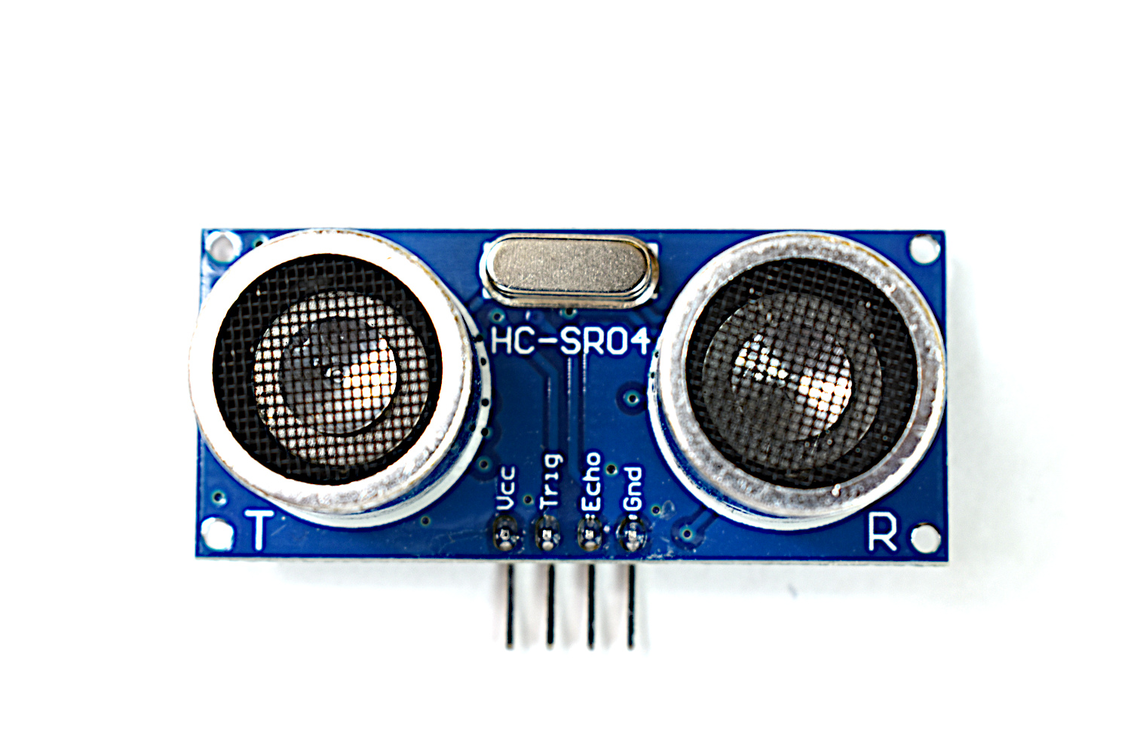
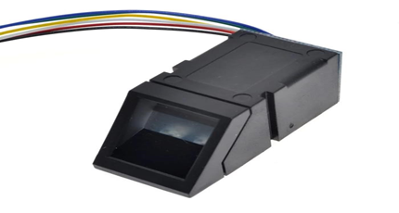
Introduction
Technologies
System Design
MQTT.Tag Design
System Model
Hardware
esp 32
Ultrasonic sensor
Fingerprint model AS608
ESP32 is a powerful and low-cost Wi-Fi chip.
low-power system on a chip microcontrollers with integrated Wi-Fi and dual-mode Bluetooth.
Software development is simple with the Arduino IDE.
36 GPIOs ports.
is a device that measures distance by sending out high-frequency sound waves and receiving the echo.
providing sensing distance of 2-400cm.
The AS608 optical fingerprint sensor can be used to scan fingerprint.
it can send the processed data to a microcontroller via serial communication.
fingerprints are stored in this module.
AS608 is capable of storing up to 162 individual fingerprints

Slide 12
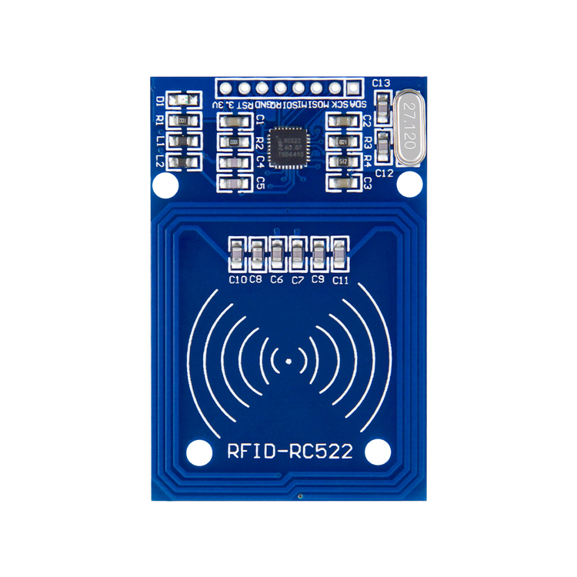
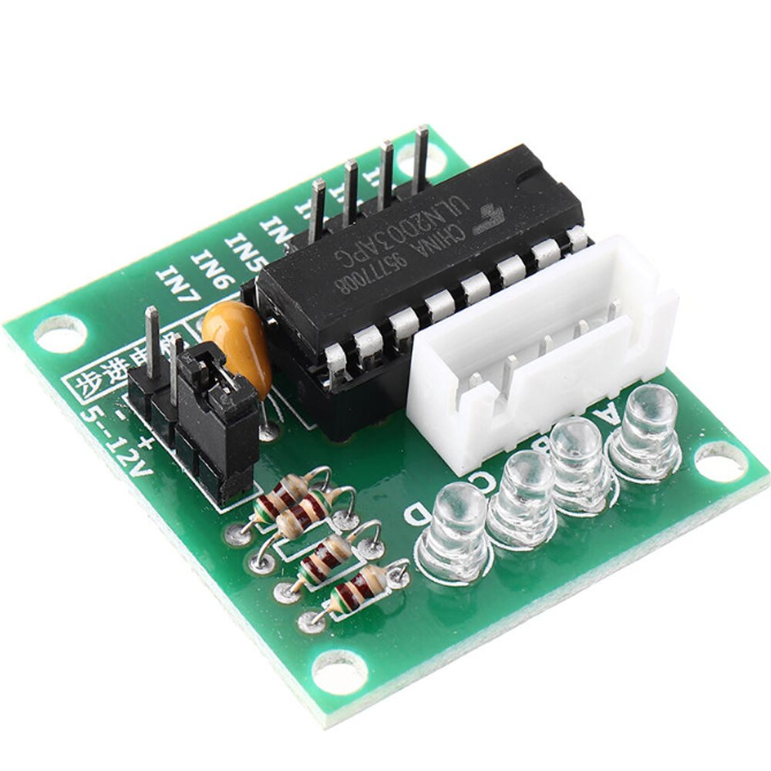
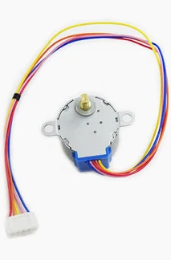
Introduction
Technologies
System Design
MQTT.Tag Design
System Model
Hardware
RFID RC522
ULN2003 Stepper Motor Driver
Stepper motor
is the highly integrated RFID card reader.
works on non-contact 13.56mhz communication.
Lower power consumption
Lower cost.
A driver designed only for the stepper motor
Contains control pins for controlling the direction of motor
a DC motor that rotates with pulses(steps) which is a fixed angle by electromagnets.
It is safe because it operates at lower temperatures even in high cycle applications.

Slide 13
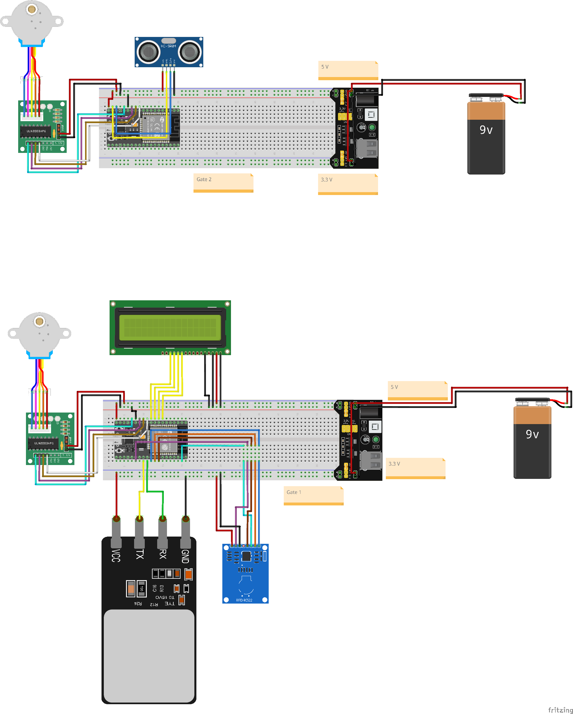
Introduction
Technologies
System Design
MQTT.Tag Design
System Model
Circuits

Slide 14
Introduction
Technologies
System Design
MQTT.Tag Design
What is MQTT.Tag ?
MQTT.Tag is application software built using java programming language to support the idea of security gates control system.

Slide 15
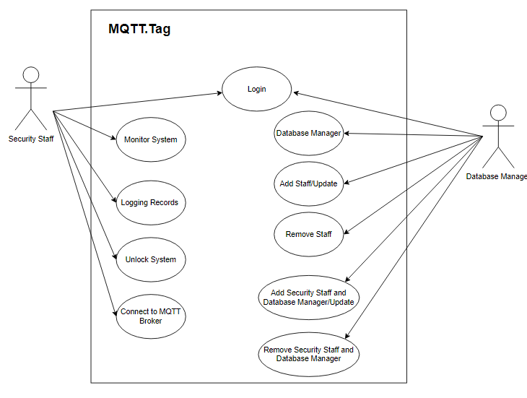
Introduction
Technologies
System Design
MQTT.Tag Design
What is MQTT.Tag ?
Features
Nice, clean and simple graphical user interface for monitoring system.
Strong back-end to process data that come from MQTT broker.
Database management system.
Recording of entries to the system in Excel file format.

Slide 16
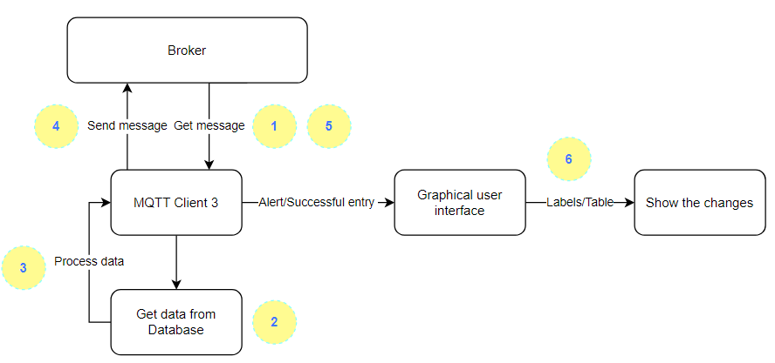
Introduction
Technologies
System Design
MQTT.Tag Design
Application Main Flow
1. MQTT.Tag get massage from the broker.
2. The MQTT client 3 will get data from the database to process it.
3. Client 3 will process the data.
4. Client 3 will send message to the client 1.
5. The client 3 will get message later about the successfully of the entry or alert.
6. The graphical user interface will interact by change the labels or tables.

